Slide 1


DEALER
TRAINING WORKBOOK
Bureau of Motor Vehicles
BMV Dealer Training
REV 12/20

Slide 2

Welcome to the Bureau of Motor Vehicles
Dealer Training
This workshop will assist you with:
Completing required paperwork to apply for title on
vehicles you sell to Maine residents.
2. Review the Bureau of Motor Vehicles
laws and forms.
3. Review the Used Vehicle Buyer’s Guide.
4. Review the Unsafe Motor Vehicle laws.

Slide 3
Maine State
Certificate of Title
MVT-1
As of January 1, 2010
All 1995 and newer vehicles are subject to Maine Title requirements.
A vehicle 1994 and older, motorcycles/mopeds under 300 cc’s, special/special mobile equipment and trailers 3000 lbs or less (empty weight) are exempt from Maine Title requirements.

Slide 4
Vehicles from other Title Jurisdictions?
New Hampshire ~ Title required for model year 2000 and newer.
Rhode Island ~ Title model year 2001 and newer
Vermont ~ 15 year Title State
Connecticut ~ 20 year Title State

Slide 5
Who and What is a
Non-Lien Holding State?
Several States mail Titles directly to owners, even though a Title may list a lien holder.
Kansas
Missouri
Kentucky
Montana
Maine (From 1/1/91 to 10/1/96)
New York
Maryland
Oklahoma
Michigan
South Dakota
Minnesota

Slide 6
Moving to the State of Maine from one of those
Non-Lien Holding States?
A Title and released Lien must be in hand, if applicable, to sell, trade, or register a vehicle.
Please, remember, the Lien Holder does not hold the Title in these states!
If they do not have the Title, they must obtain a duplicate from that State before they can sell, register, or apply for Title in Maine.

Slide 7
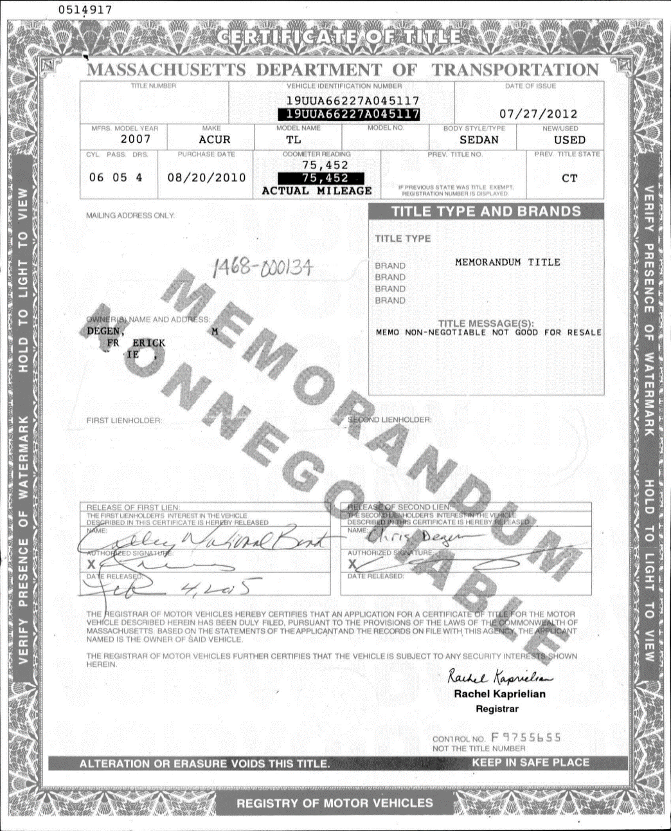
What is A Memorandum Titles?
A Memorandum Title is a non-negotiable title issued when the owner of a vehicle moves to a state that issues Memorandum Titles and the out of state title is held by the lienholder and not surrendered to that state at time of registration.

Slide 8
Who issues Memorandum Titles?
Connecticut
District of Columbia
Kansas (Trucks and Commercial Vehicles Only)
Massachusetts
Missouri
Ohio
Pennsylvania
Rhode Island (as of 11/7/03)
South Carolina
Texas
West Virginia
Remember, the State of Maine will not accept Memorandum Titles as proof of ownership!

Slide 9
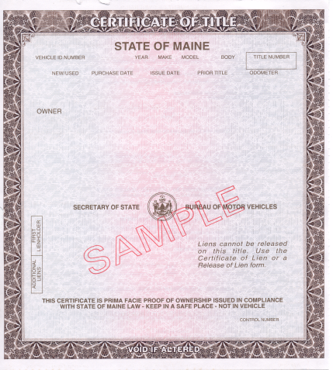
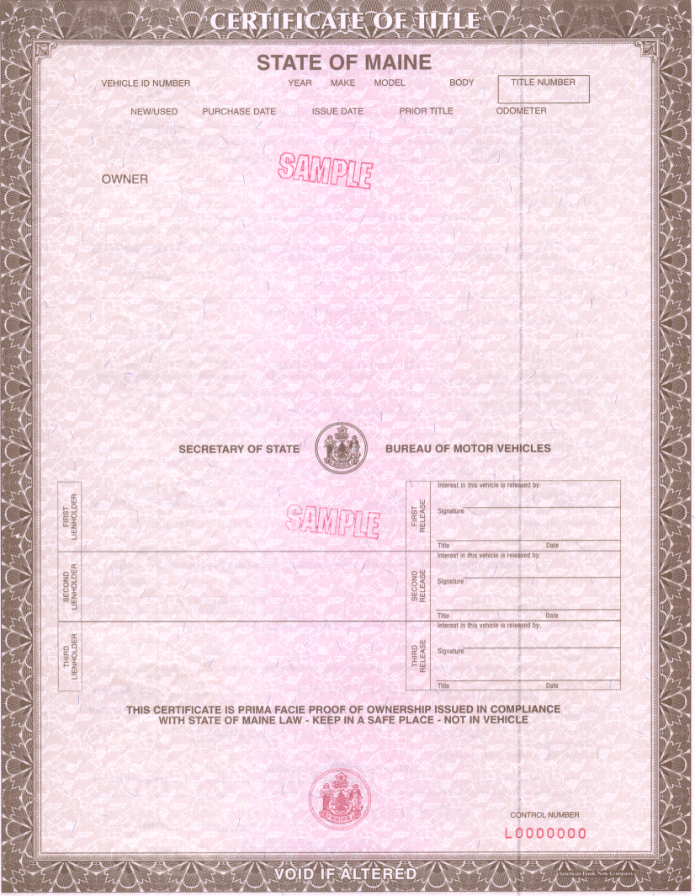
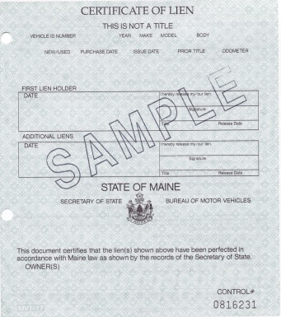


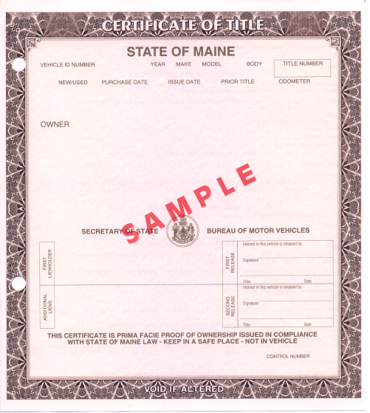


Changes to the
Maine State
Certificate of Title
MVT-1
Jan. 1, 1991 to Oct. 1, 1996
Feb. 1, 1999 to June 2015
Certificate of Lien MVT-17
Oct. 1, 1996 to Jan 31, 1999

Slide 10
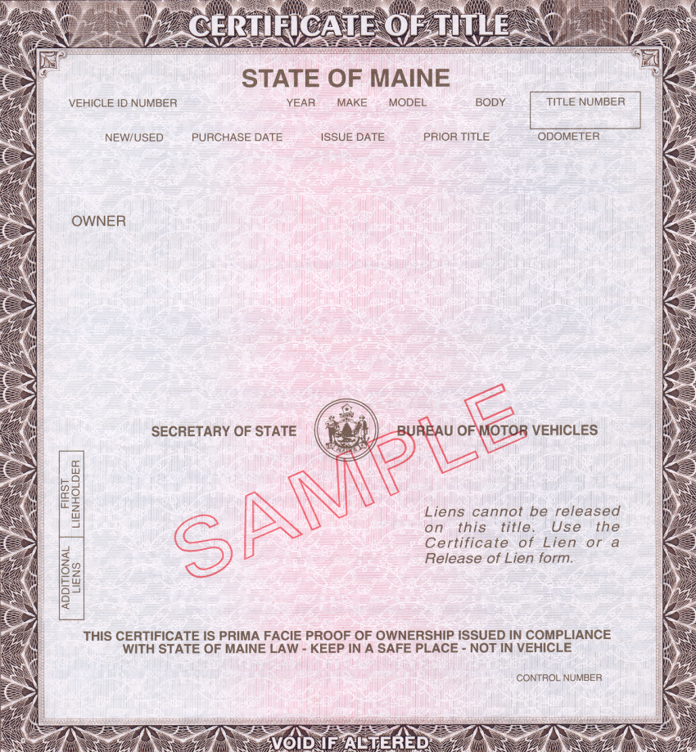
Maine Certificate of Title issued
January 1991 thru October 1996
MVT-1

Slide 11
CERTIFICATE of LIEN
Certificate of Lien (MVT-17) were issued from 1/1/91 to 10/1/96.
Released with an MVT-12
Must be properly signed off by the lien holder
The information on this Certificate of Lien must match the Certificate of Title exactly.

Slide 12
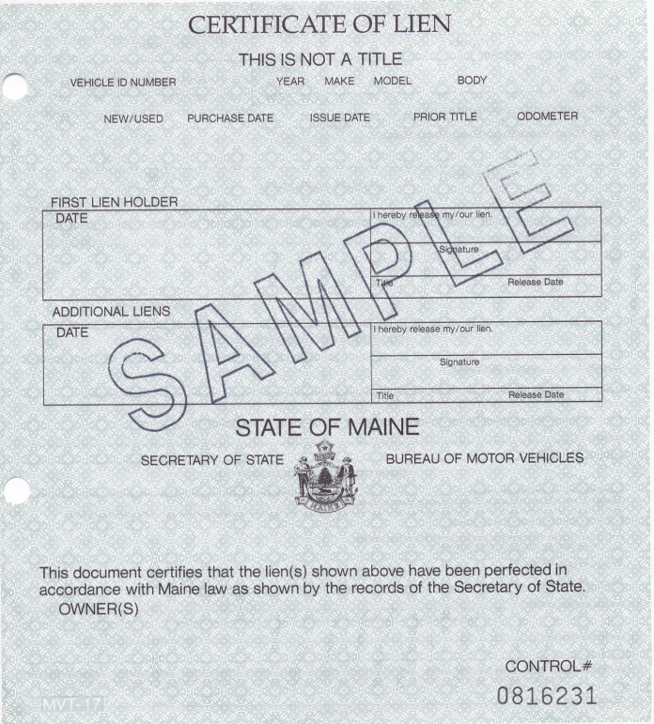
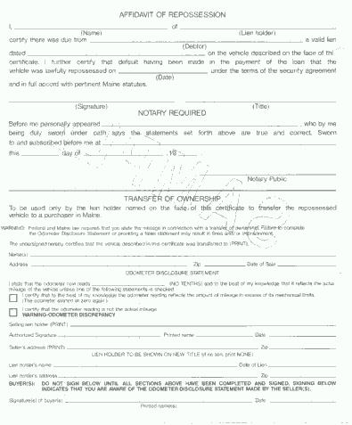
Maine Certificate of Lien required for Titles issued
January 1991 thru October 1996
MVT-17

Slide 13

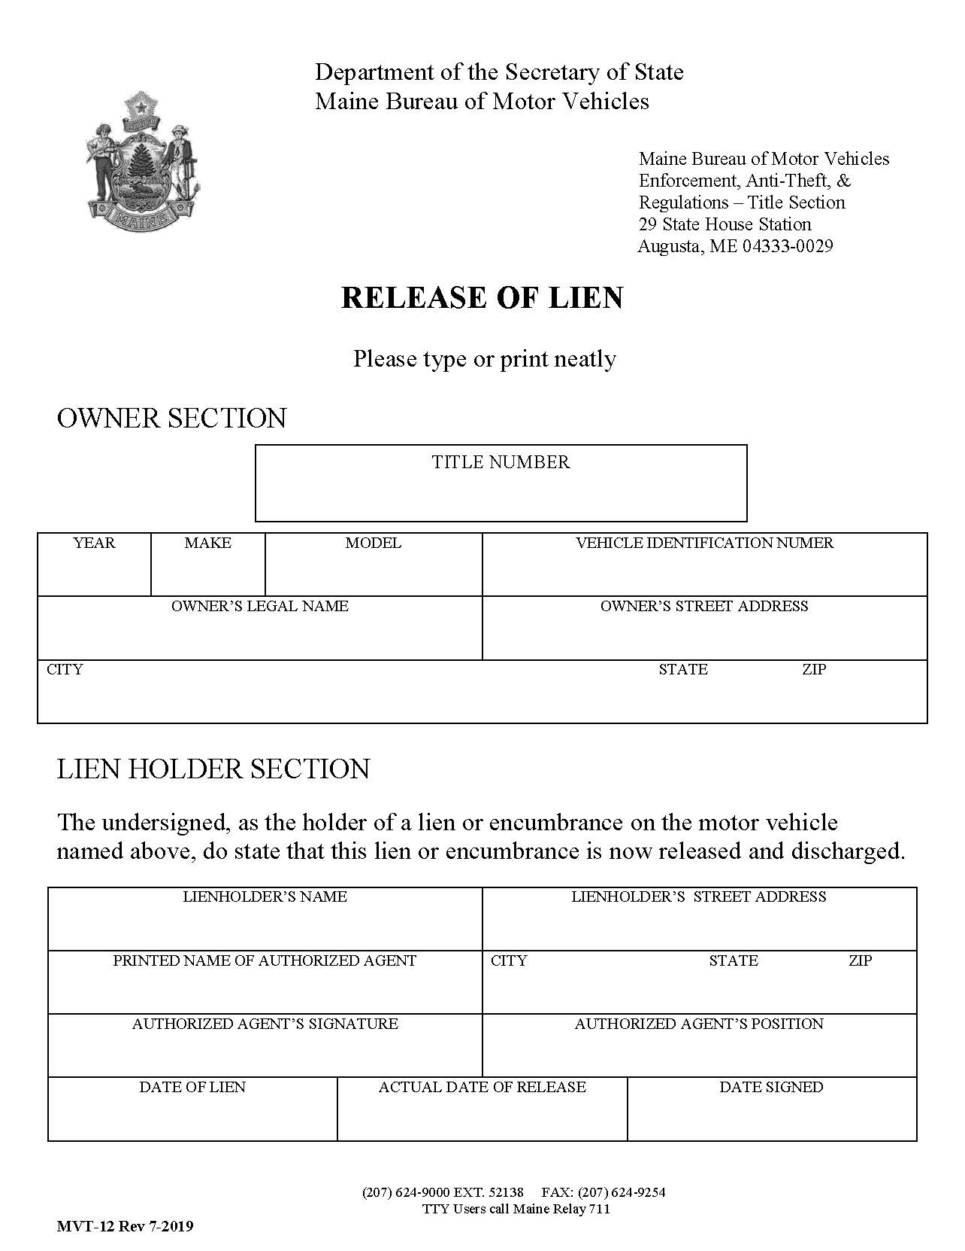

Release of Lien
MVT-12
An MVT-12 can be used by the Lien Holder to show a release of lien when it cannot be released on the face of the title or in the case where a Certificate of Lien has been lost or destroyed.
8765432
2018
TOYT
TACOMA
5TFSZ5AN3JX084629
Richard & Angela Smith
99 Main Street
Authorized Agent information must be legible and position listed.
Augusta ME 04330
Klondike Bank & Trust
981 Washington Street
James Snowman
Presque Isle, ME 04769
James Snowman
Loan Officer
Once the Lien (s) is released by all Lien Holders, the Vehicle is Free of Encumbrances and able to be transferred.
01/07/17
09/07/17
09/22/17

Slide 14
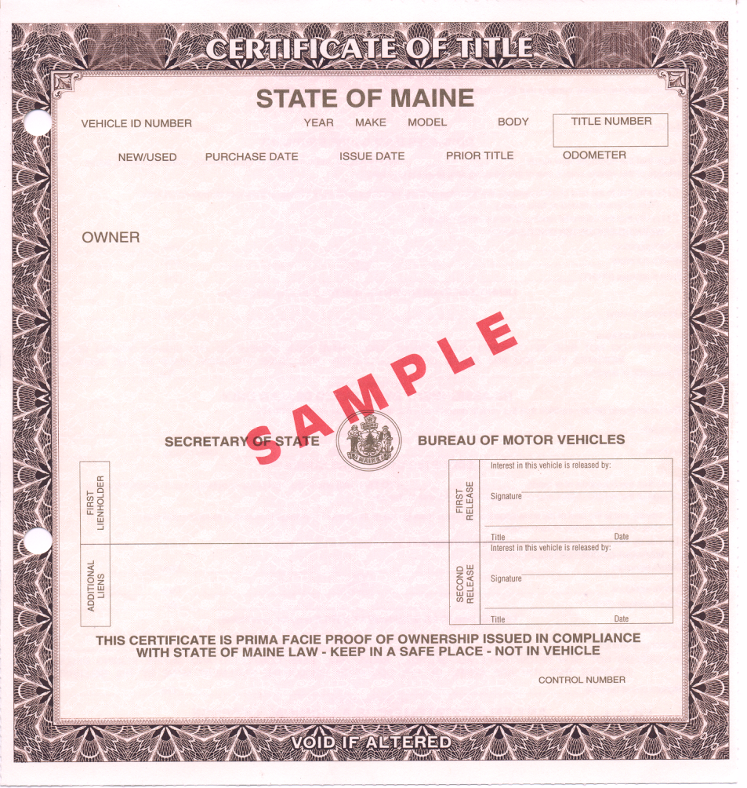

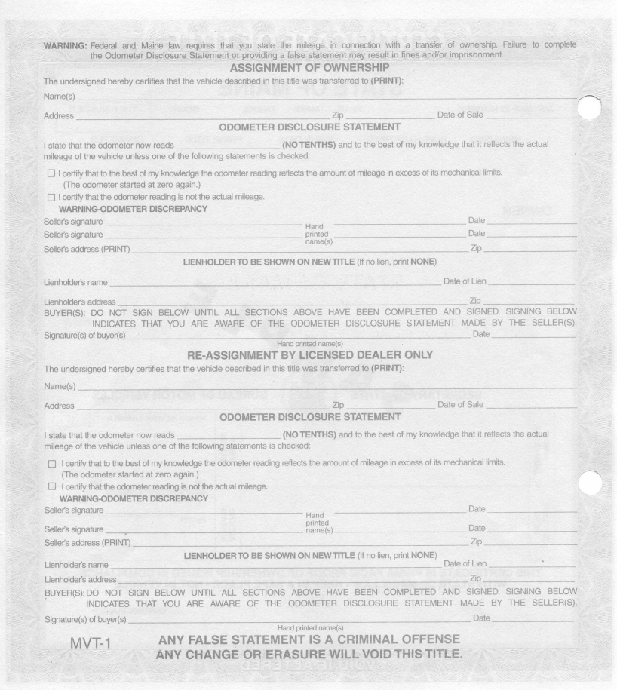

Maine Certificate of Title issued
October 1, 1996 thru January 31, 1999
MVT-1

Slide 15
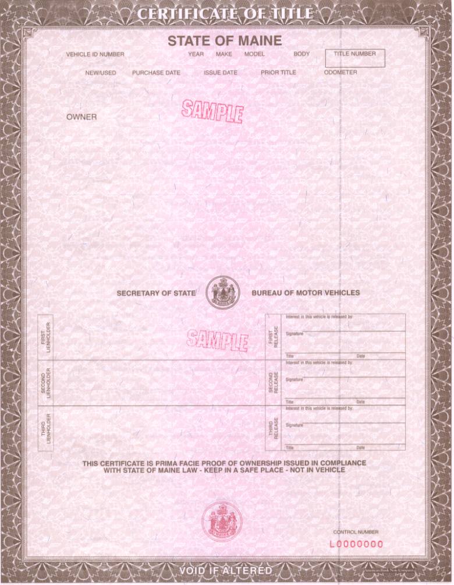
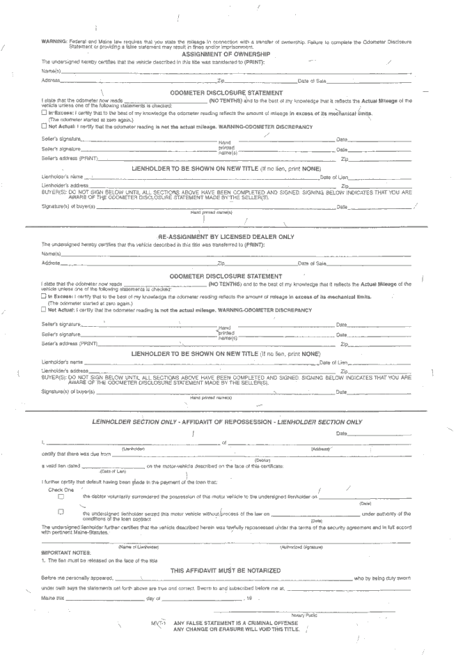
Maine Certificate of Title issued
February 1, 1999 to June 2015
MVT-1

Slide 16
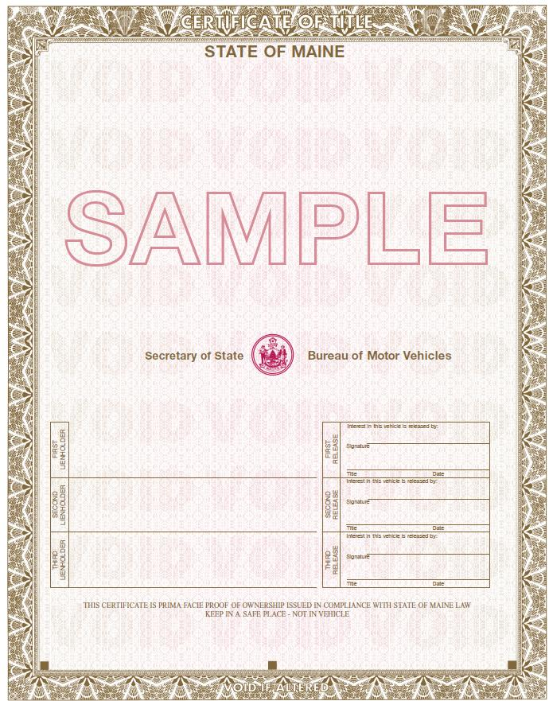
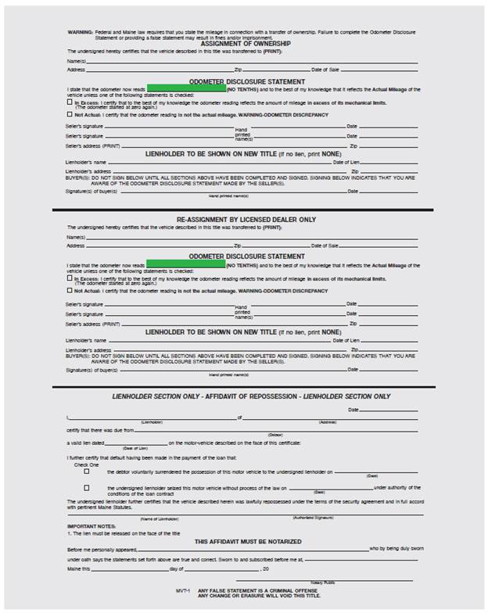
Maine Certificate of Title
Issued
June 2015 to April 2019
MVT-1

Slide 17
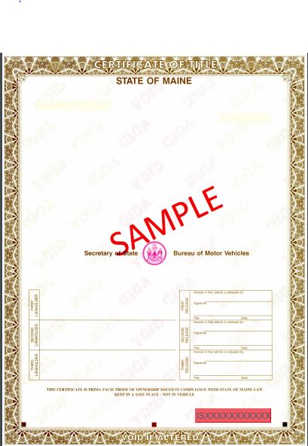
Maine Certificate of Title
Issued
April 2019 to Current
MVT-1

Slide 18
Sample Title

Slide 19
Certificate of Origin
MCO
New vehicles and trailers, delivered
in Maine by the manufacturer or
franchise dealer, must execute and
deliver to an agent or franchised
dealer, a Certificate of Origin.
A Certificate of Origin or MCO
is the birth certificate for a new vehicle.

Slide 20
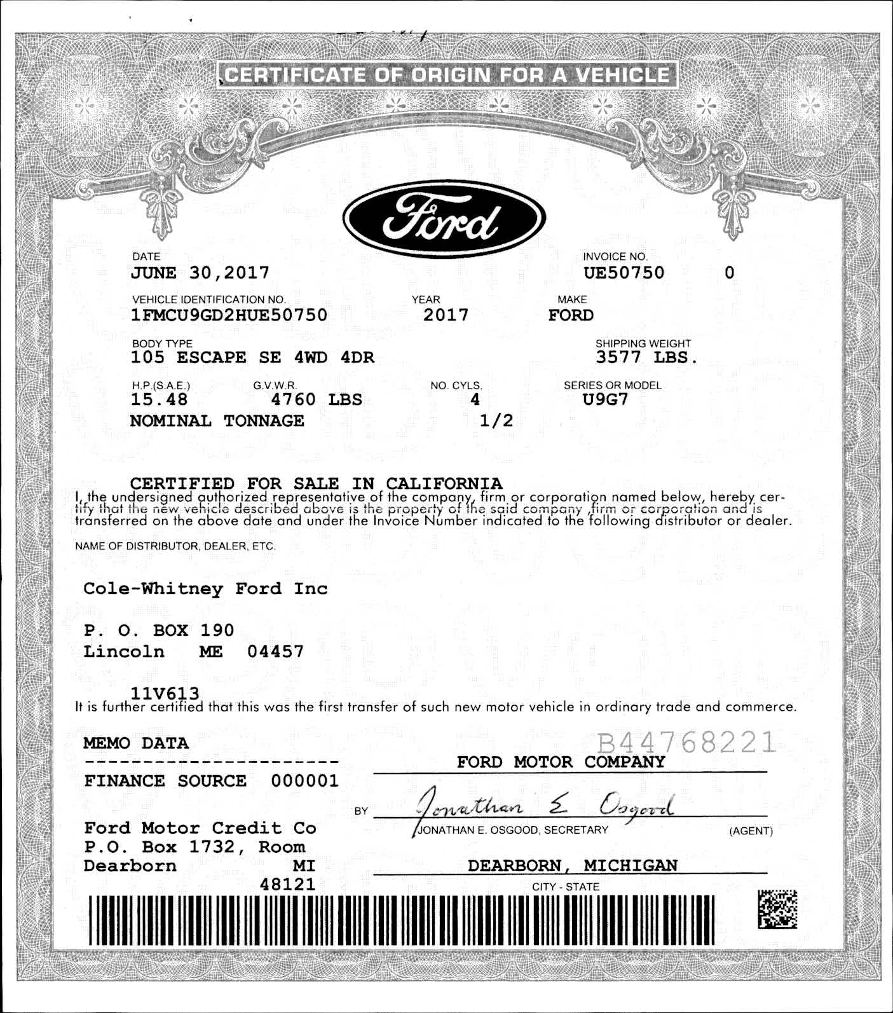
Certificate of Origin
MCO

Slide 21
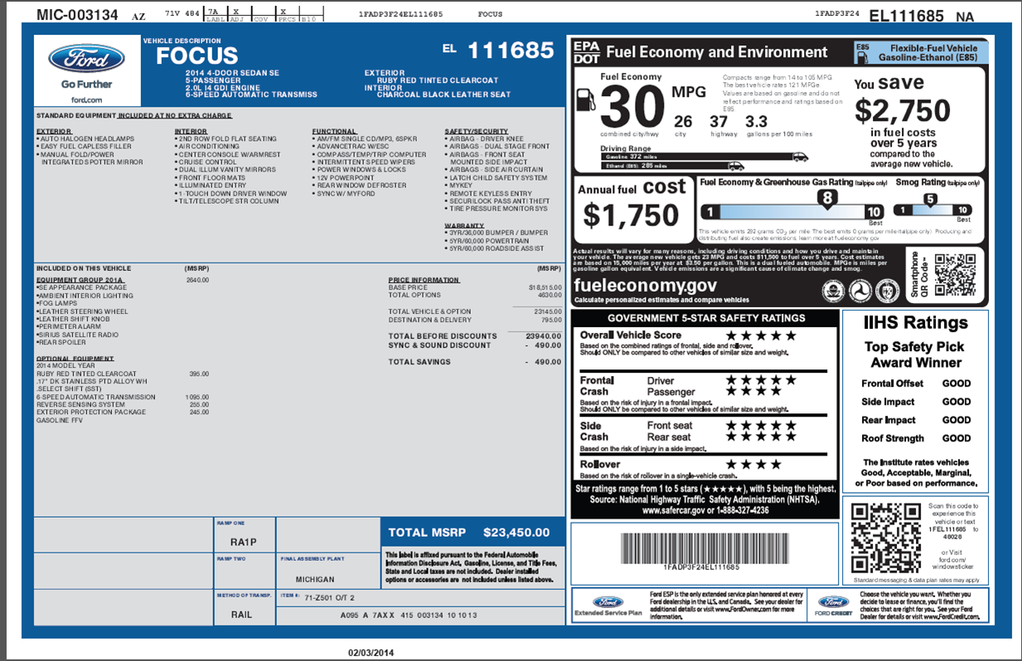
Monroney Label
(Window Sticker)

Slide 22

Monroney Label
(Window Sticker)
Manufacturer Suggested Retail Price (MSRP) is calculated by using the
Total Vehicle Price
Less The Destination Charge
Total Vehicle Price $23,145
Less Destination - $795
Equals MSRP $22,350
EQUALS MSRP

Slide 23

Transfer of Ownership
Are the keys all that’s needed?

Slide 24
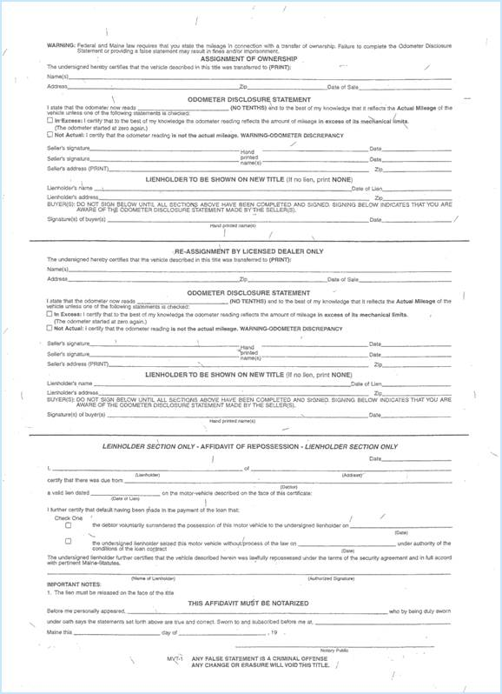
Transfer of Ownership
MVT-1
*
Verify vehicle ownership!
*
Initiate vehicle transfers for vehicles 1995 and newer on the reverse side of the Title (MVT-1)
*
*
*
Purchaser(s) name and Address and date of the sale
Accurate current mileage
Seller(s) name, signature(s), address and date of the sale
Lienholder's information
Signature of purchaser(s)

Slide 25
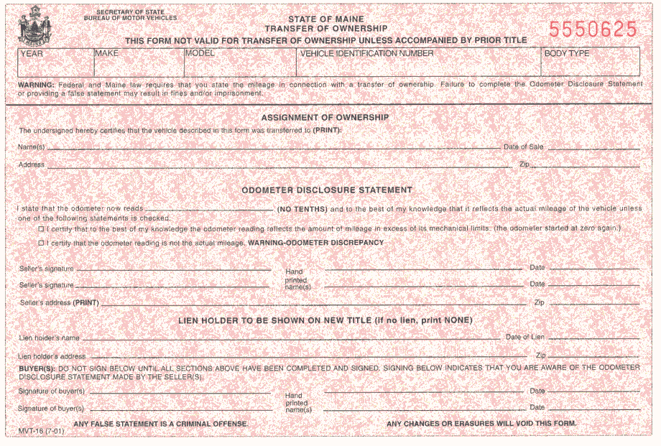
Transfer of Ownership
MVT-16
2018
TOYT
TACOMA
5TFSZ5AN3JX084629
PK
Richard & Angela Smith
01/07/17
99 Main Street, Augusta, Maine
04330
78
Alan Churchill, Office Manager Exceptional Auto
Alan Churchill
01/07/17
Exceptional Auto
45 Second Street, Randolph, Maine
04345
Klondike Bank & Trust
01/07/17
981 Washington Street, Presque Isle, Maine
04769
Richard Smith
Richard Smith
01/07/17
Angela Smith
Angela Smith
01/07/17
To be a valid transfer, the MVT-16 must be accompanied by a Title.

Slide 26
29-A M.R.S.A. § 851 (12)
NEW vs USED
“Used motor vehicle” means a motor vehicle that has been registered at least once or is not covered by a manufacturer's new car warranty.

Slide 27
Application for Certificate of Title
MVT-2
How much does an Application for Title cost?
The Application fee is $33 (normal processing10-12 weeks from date of receipt in Title Production unit. During times of high backlog, updated processing times will be listed on our website.)
An additional $10 for an EXPEDITED (RUSH).
(12-14 business days from date application is received at main office)
How soon after a Dealer makes a sale or lienholder finances a vehicle should a Title Application be submitted to BMV?
Dealerships and Financial Institutions must submit an application to Motor Vehicles within 30 days of the sale or start of approved lien.
After 30 days, there is a $50 late fee per application and this violation is a misdemeanor in Title 29A, section 664-A ~ a Class E offense.

Slide 28
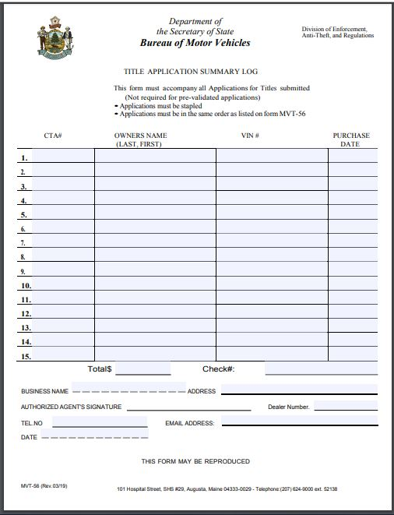
Must be submitted by Maine dealers with multiple applications.
MVT-56
Form must be fully completed. Available on-line for download.
Not required when pre-validated applications are submitted.

Slide 29
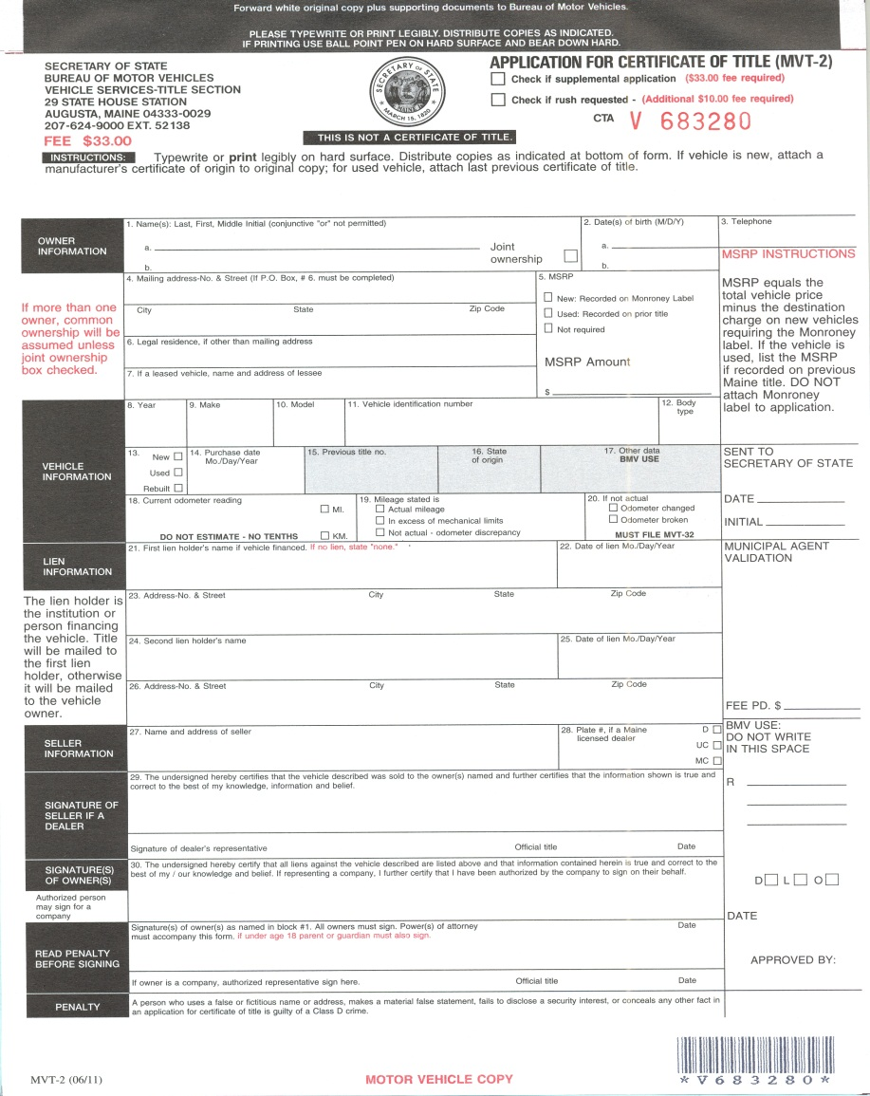
Application for Certificate of Title
MVT-2
CTA Number
Title Fee $33
G 123456
Rush (+ $10)
Must be original application. Photocopies are not acceptable.

Slide 30
Application for Certificate of Title
MVT-2
Line #3
Telephone Number
Line #1
Last Name, First Name, Middle Initial of owners
G 123456
Check Joint Ownership and the survivor owns the vehicle without any question!
Smith, Richard L
11/29/56
207-555-1234
Smith, Angela S
02/25/64
Line #2
Date of Birth
If there are multiple titled owners, but Joint Ownership is not checked, Common Ownership is established.

Slide 31
Application for Certificate of Title
MVT-2
Line #4 Mailing Address, (Street Name & Number)
Line #6 Please complete, so the Title Section has required information to locate owner if required.
Line #7 Complete if this is a leased vehicle.
G 123456
Line #5 MSRP ~ Fill in the appropriate amount (Total vehicle price less destination charge equals total) if this is a new vehicle or the MRSP has been listed on prior Title. Otherwise check mark “not required”.
Smith, Richard L
11/29/56
207-555-1234
Smith, Angela S
08/25/64
PO Box 54
Augusta ME 04330
99 Main Street, Augusta, ME 04330
38,915

Slide 32

Application for Certificate of Title
MVT-2
G 123456
Lines #8 - #17
Vehicle Information:
Smith, Richard L
11/29/56
207-555-1234
Smith, Angela S
08/25/64
Lines #18 - #20 Current Odometer
DO NOT GUESS
be accurate!
If it is not actual, state that and submit an MVT-32 Odometer Information form with this application.
PO Box 54
Augusta ME 04330
99 Main Street, Augusta, ME 04330
38,915
Year, Make, Model, VIN, Body Type, Condition, Purchase Date, Previous Title Number, State of Origin
2018 TOYT TACOMA 5TFSZ5AN3JX084629 PK
01/07/17
MCO
ME
78

Slide 33
Application for Certificate of Title
MVT-2
G 123456
Lines #21 - #26
Lien Information
Lienholder name and address must be complete.
Smith, Richard L
11/29/56
207-555-1234
Smith, Angela S

08/25/64
PO Box 54
Augusta ME 04330
95 Chestnut Street, Augusta, ME 04330
38,915
2018 TOYT TACOMA 5TFSZ5AN3JX084629 PK

MCO
01/07/17
ME


78
Klondike Bank & Trust
01/07/17
Lines #27 - #29
Seller Information
Remember to include your Dealer License # and check Dealer Type Box
981 Washington Street Presque Isle ME 04769
Line #30 Signatures of Owners
All owners listed in block one must sign.
Exceptional Auto
9002
45 Second Street, Randolph, ME 04345
Alan Churchill
Office Manager
01/07/17

Richard Smith
Angela Smith
01/07/17

Slide 34
Odometer Information
MVT-32
2018 TOYO 5TFSZ5AN3JX084629 01/01/17
Richard & Angela Smith 95 Chestnut St Augusta Me 04330
MVT-32 is
used when a
questionable
odometer reading
occurs on the
MVT-2 or when an odometer is
non-functional and replaced.
Odometer reading when stopped
working
Miles driven
while odometer
not working
01/01/17 Henry Davis
Henry Davis
Davis Auto Repair
If Repaired/Replaced
Odometer set at

Slide 35
Affidavit of Repossession
Reverse of Maine Title.

Slide 36
Affidavit of Repossession
MVT-5
08/05/17
Klondike Bank & Trust
James Snowman
981 Washington Street, Presque Isle, ME 04769
01/07/17
Richard & Angela Smith
2018 TOYT 5TFSZ5AN3JX084629 30258456
08/05/17
Klondike Bank & Trust
James Snowman Loan Officer
Notary Signature
MVT-5 may be submitted to show repossession instead of repossession being executed on reverse of title.
James Snowman
August
Presque Isle, Aroostook County
5th
17
Mary T. O’Donnell

Slide 37
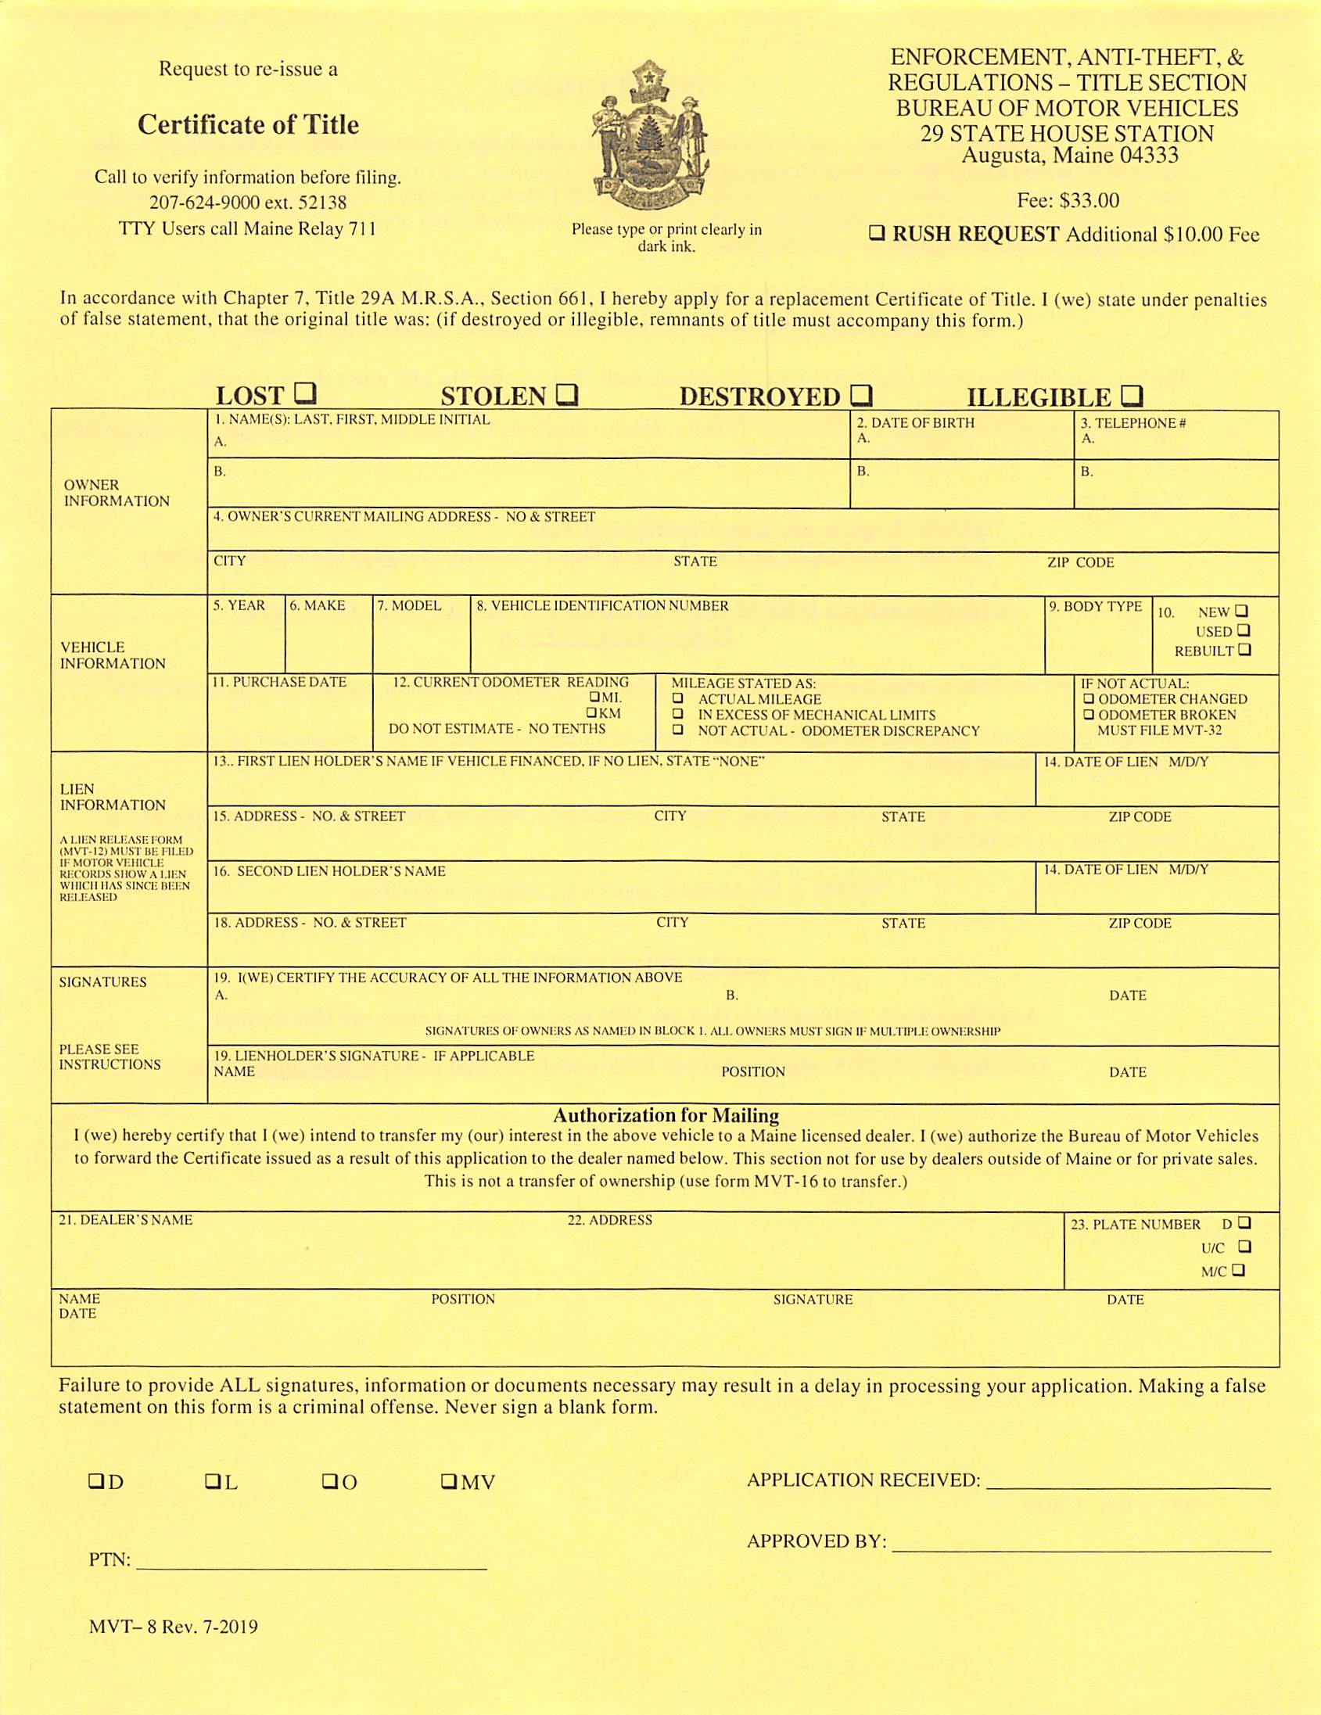
Duplicate
Certificate of Title
MVT-8
$33 Fee for the Duplicate plus $10 Fee for RUSH.
Richard And Angela Smith found a car they really would like to buy at Exceptional Auto of Randolph, Maine, but Lost the Title. How can they close the deal without it?
Smith, Richard
Smith, Angela
11/29/56
207-555-1234
PO Box 54
08/25/64
207-555-1234
99 Main Street
Augusta ME 04330
But!
2018 TOYT TACOMA 5TFSZ5AN3JX084629 PK
Prior title still shows active Lien
on our system.
Richard Smith
Angela Smith
01/07/17
They will acquire a signed Release of Lien (MVT-12) from Klondike Bank & Trust that indicated this loan was paid in full on their 2018 Toyota Tacoma. The lien release must be submitted to Titles before a duplicate may be issued.
Exceptional Auto
45 Second St, Randolph ME 04345
9002
Alan Churchill
Office Manager
Alan Churchill
12/18/13

Slide 38
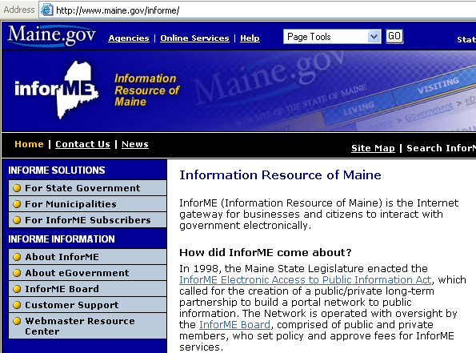
INFOR-ME
A second way to obtain BMV Information:
An Internet Service that provides 24 hour/ 7 days a week access.
http://www.maine.gov/informe/
An “annual” Subscription Fee of $100 and a $5.50 look-up fee per Title record inquiry is available.
InforME can be contacted at: (207) 621-2600
or 1-877-212-6500

Slide 39
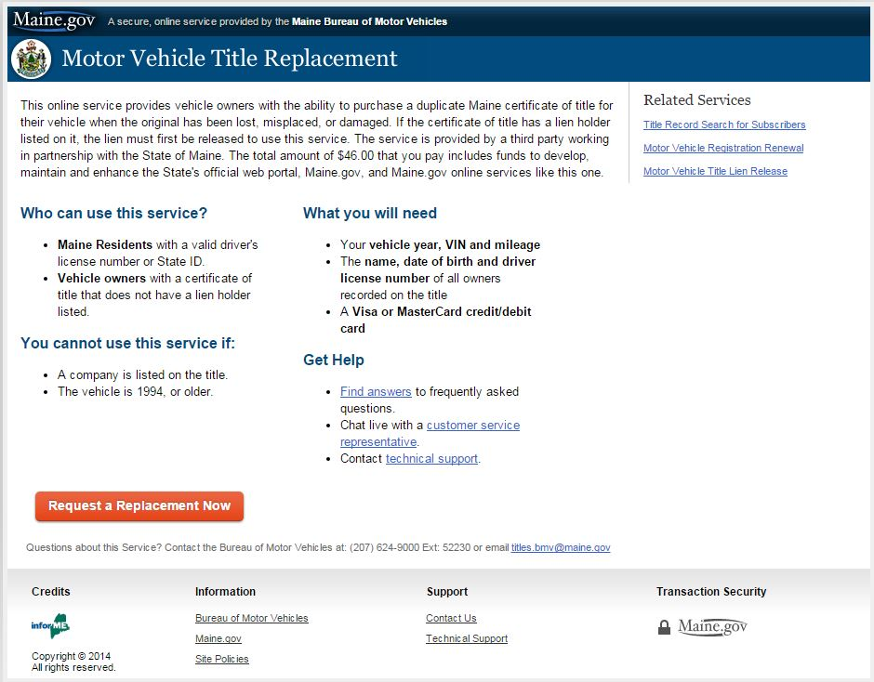
INFOR-ME
On-Line Duplicate Title
$46.00 Fee
$33.00 Title Fee
$10.00 Rush Fee
$3.00 Processing
Fee

Slide 40
Request for Withdrawal
MVT-3
Richard & Angela discovered their recently purchased 2015 Ford Taurus had been in an accident and was not disclosed at the time of sale. They have brought the vehicle back to Exceptional Auto for a refund.
01/10/17
Exceptional Auto
G 123896
01/11/17
Richard & Angela Smith
FORD
1FMCU23JX08762194
2015
d
Can Exceptional Auto cancel this transaction? If so, how?
Undisclosed Information
Is the title fee refunded? NO
Richard Smith
Angela Smith
Please note: If the vehicle has been registered to the applicant, the Application for Title (MVT-2) cannot be withdrawn.
Alan Churchill
Office Manager, Exceptional Auto
Alan Churchill
James Snowman
Loan Officer,
Klondike Bank & Trust

Slide 41
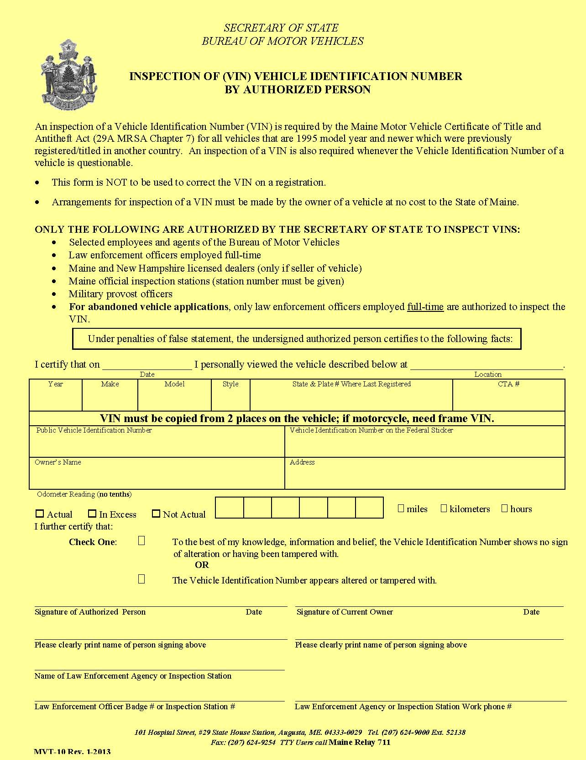
Inspection of Vehicle Identification
MVT-10
Required whenever the Vehicle Identification Number of a vehicle is questionable or a vehicle coming in from another country.
03/15/17
45 Second Street
Randolph ME
2013 FORD TAURUS SD Maine G 123896
1FMCU23JX08762194 1FMCU23JX08762194
Richard & Angela Smith PO Box 54, Augusta ME
4 4 5 2 7
Shawn Niely 03/15/17
Richard Smith 03/15/17
Shawn Niely, State Inspection Agent
Richard Smith, Owner
Exceptional Auto #1687
207-555-6528

Slide 42
Vehicles Coming Into Maine from Another Country
MVT-2 ~ Title Application in the owner(s) name.
Manufacturer’s Certificate of Origin (MCO), from Canada,
a Canadian registration in the selling dealer’s name.
MVT-10 Vehicle Identification Statement
A Bill of Sale
Import Documents:
A. Dept. or Transportation’s HS-Form 7 Declaration
B. U.S. Customs Entry Form #7501, or CF-3299 or CF-368
C. Military documentation ~ DD 1252 & DD 788 or Only HS-Form 7
D. Bond or Bond release if question #3 has been answered on
Declaration
E. Work order for odometer change, if one was done
Required Title Fee

Slide 43
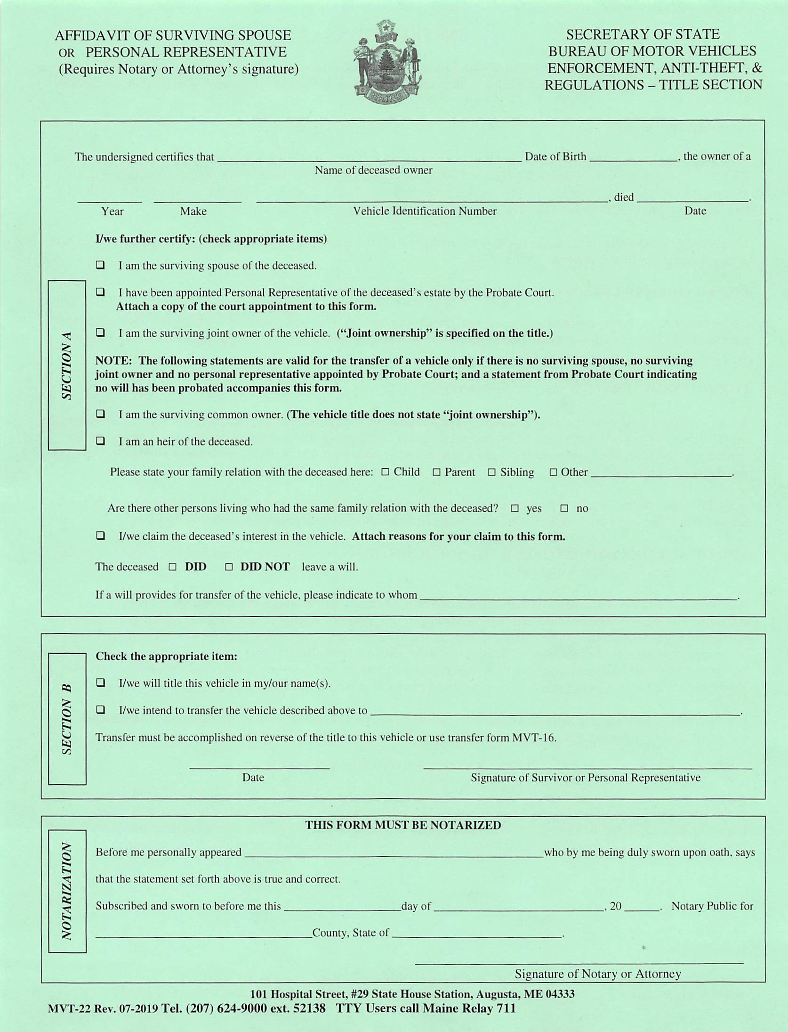
Affidavit of Surviving Spouse
MVT-22
Angela Smith
08/25/64
2018
TOYT
5TFSZ5AN3JX084629
09/10/17
MVT-22 is used when the owner(s) of a vehicle has died.
09/28/17
Richard Smith
Richard Smith
Kennebec
28th
September
17
Maine
Mary T. O’Donnell

Slide 44
Death of an Owner - Surviving Spouse
Keeping Vehicle: Title MVT-22 completed by surviving spouse MVT-2 in surviving spouse’s name No Fee for MVT-2 only if prior title is Maine A $33.00 fee if spouse is adding a name 5. $10.00 fee for a rush process | Selling Vehicle-Provide New Owner with the following: Title MVT-22 completed by surviving spouse Transfer of ownership from surviving spouse to new owner
Keeping Vehicle - Maine Title Lost: MVT-8 in prior owner’s name(s) signed by the surviving spouse MVT-22 completed by surviving spouse MVT-2 in surviving spouse’s name No Fee for MVT-2 and MVT-8 A $33.00 fee for MVT-2 if spouse is adding a name 5. $10.00 fee for a rush process | Selling Vehicle - Maine Title Lost: Surviving spouse must obtain a title in their name first before selling. See instructions in Keeping Vehicle – Maine Title Lost Provide new owner with the following: Title in surviving spouse’s name Transfer of ownership from all owners named on new title to new owner

Slide 45
Death of an Owner - Personal Representative
Keeping Vehicle: Title Copy of personal rep’s court appointment MVT-2 in personal rep’s name(s) $33.00 fee Additional $10.00 fee if rush request | Selling Vehicle - Provide New Owner with the following: Title Copy of personal rep’s court appointment Transfer of ownership from personal rep(s) to new owner
Keeping Vehicle – Maine Title Lost: MVT-8 in prior owner’s names(s) signed by the personal rep Copy of personal rep’s court appointment MVT-2 in personal rep’s name(s) $33.00 fee for MVT-2 Additional $10.00 fee if rush request | Selling Vehicle – Maine Title Lost: Personal Rep must obtain a title in their name first before selling. See instructions in Keeping Vehicle – Maine Title Lost Provide new owner with the following: Title in personal rep’s name(s) Transfer of ownership from all owners named on new title to new owner

Slide 46
Death of an Owner - Joint Owner
Keeping Vehicle: Title Copy of death certificate MVT-2 in joint owner’s name 4. No fee for MVT-2 if surviving joint owner is surviving spouse A $33.00 fee if surviving joint owner is not the surviving spouse or if another name is added 5. Additional $10.00 fee if rush request | Selling Vehicle - Provide New Owner with the following: Title Copy of death certificate Transfer of ownership from surviving joint owner to new owner
Keeping Vehicle – Maine Title Lost: MVT-8 in prior owner’s names signed by the surviving joint owner Copy of death certificate MVT-2 in surviving joint owner’s name No fee for MVT-2 and MVT-8 if surviving joint owner is the surviving spouse A $33.00 fee for MVT-2 & MVT-8 if surviving joint owner is not the surviving spouse or if surviving spouse is adding a name 5. Additional $10.00 fee for rush request | Selling Vehicle - Maine Title Lost: Surviving joint owner must obtain a title in their name first before selling. See instructions in Keeping Vehicle – Maine Title Lost Provide new owner with the following: Title in joint owner’s name Transfer of ownership from all owners named on new title to new owner

Slide 47
Heirs of the Deceased-No Personal Representative Appointed by the Court
Keeping Vehicle: Title MVT-22 completed by all immediate heirs spouse children parent(s) sibling(s) Statement from probate court no will probated Transfer of ownership (when required) MVT-2 in heir’s name(s) $33.00 fee Additional $10.00 fee for a rush request | Selling Vehicle-Provide New Owner with the following: Title MVT-22 completed by all immediate heirs spouse children parent(s) sibling(s) Statement from probate court no will probated Transfer of ownership from heir(s) to new owner
Keeping Vehicle- Maine Title Lost: MVT-8 in prior owner’s name(s) signed by all heirs MVT-22 completed by all immediate heirs spouse children parent(s) sibling(s) Statement from probate court no will probated MVT-2 in heir’s name(s) Transfer of ownership (when required) $33.00 fee for MVT-2 Additional $10.00 fee if rush request | Selling Vehicle- Maine Title Lost: Heir(s) must obtain a title in their name(s) first before selling. See instructions in Keeping Vehicle – Maine Title Lost Provide new owner with the following: Title in heir’s name(s) Transfer of ownership from all owners named on new title to new owner

Slide 48
Application for Certificate of Salvage
MVT-102
Salvage Vehicle Dealers and Auctions
Legislation requires Insurance Companies to obtain Salvage Titles for total loss vehicles prior to transferring them.
The Secretary of State requires this application for a Salvage Title for any total loss, even if the owner retains the salvage.
Remember: The insurance company must act on the application within 30 days of its receipt.

Slide 49
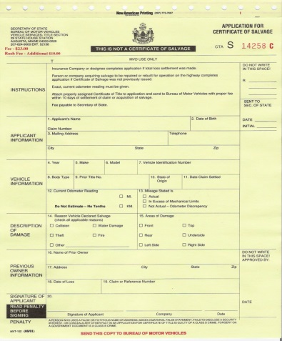
Application for Certificate of Salvage
MVT-102
CTA S Number
Newport Insurance Company
A54321
93 Pine Street
Portland, Maine 04101
207-999-1234
12 FORD TAURUS 2FMZU7EF3CFB79954
4DR 8765432 ME 09/10/17
26,347
George M. MacAfee
34 Spruce Street Augusta, ME 04330
N/A
William J. Newport, President 09/10/17

Slide 50
Certificate of Salvage Title
Collision Damage
Water Damage
Theft
Fire Damage
Comprehensive

Slide 51
Affidavit of Rebuilt or Repaired Salvage Vehicle
MVT-103
If a vehicle has been declared a total loss by an insurance company or vehicle owner, an MVT-103 form must be completed by the repairer to list repairs on the vehicle.
List the parts used to replace or repair the damaged ones as (N) new, (U) used, or (R) repaired.
Copies of the bill of sale or invoice for new parts must be sent in with the MVT-103 form.
When repairing the vehicle with used parts, list the VIN number from the “parts” vehicle, as well as the Title State, Title Number and Date Title Surrendered.
If 1-4 component parts are replaced, the vehicle will be coded “Rebuilt” on the title.
If 5 or more component parts have been replaced, “Rebuilt Salvage” will be coded on the title.
If the vehicle has been declared totaled and no parts were replaced, but the vehicle was repaired, an MVT-103 must be completed by the repairer, “Repaired” will be coded on the title.

Slide 52
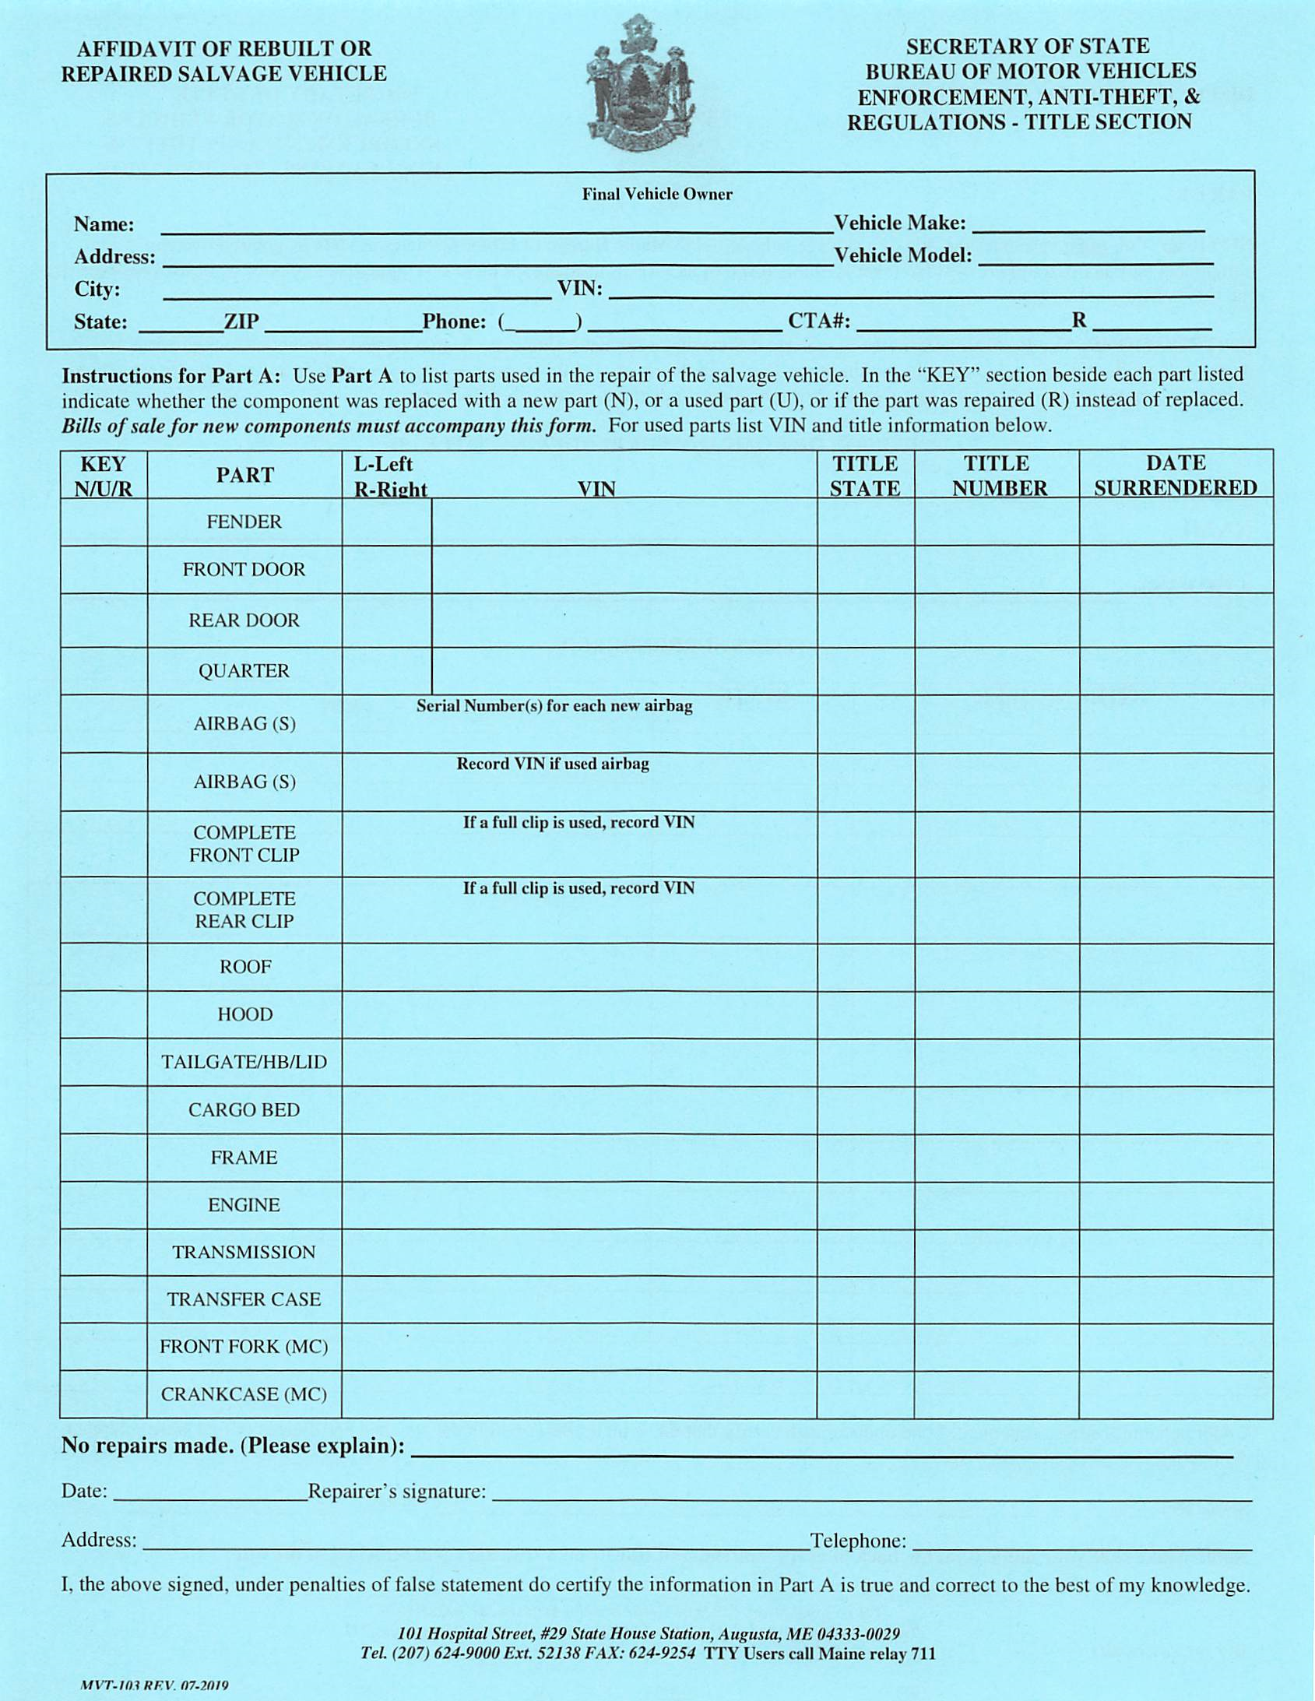
Affidavit of Rebuilt or Repaired Salvage Vehicle
MVT-103
Johnny Applebee FORD
126 Macintosh Lane S-10
Augusta 1FUD346TUE3456435
ME 04330 207 555-1234 NN29656
If USED parts please enter title state, title number and date title surrendered for each used part
ME 12356525 03/25/16
UU
123ABC456EFG78A9
ME 10549521 02/19/16
U
456ABC123EFG89A9
If NEW parts
please attach bill of sale/invoice for each new part used
N
Need Bill of Sale/Invoice Attached
N
Need Bill of Sale/Invoice Attached
R
R
09/07/17 Kenneth Arrows
156 Repair Road Augusta ME 04330 (207) 555-8954

Slide 53
Disposition of Salvage Vehicle
MVT-103
Part B: (Reverse of MVT-103)
Part B of the MVT-103 must be completed and mailed along with the title from any vehicle that has been:
Compressed
Scrapped
Destroyed
Dismantled
Note: The MVT-103 must be used when surrendering titles.

Slide 54
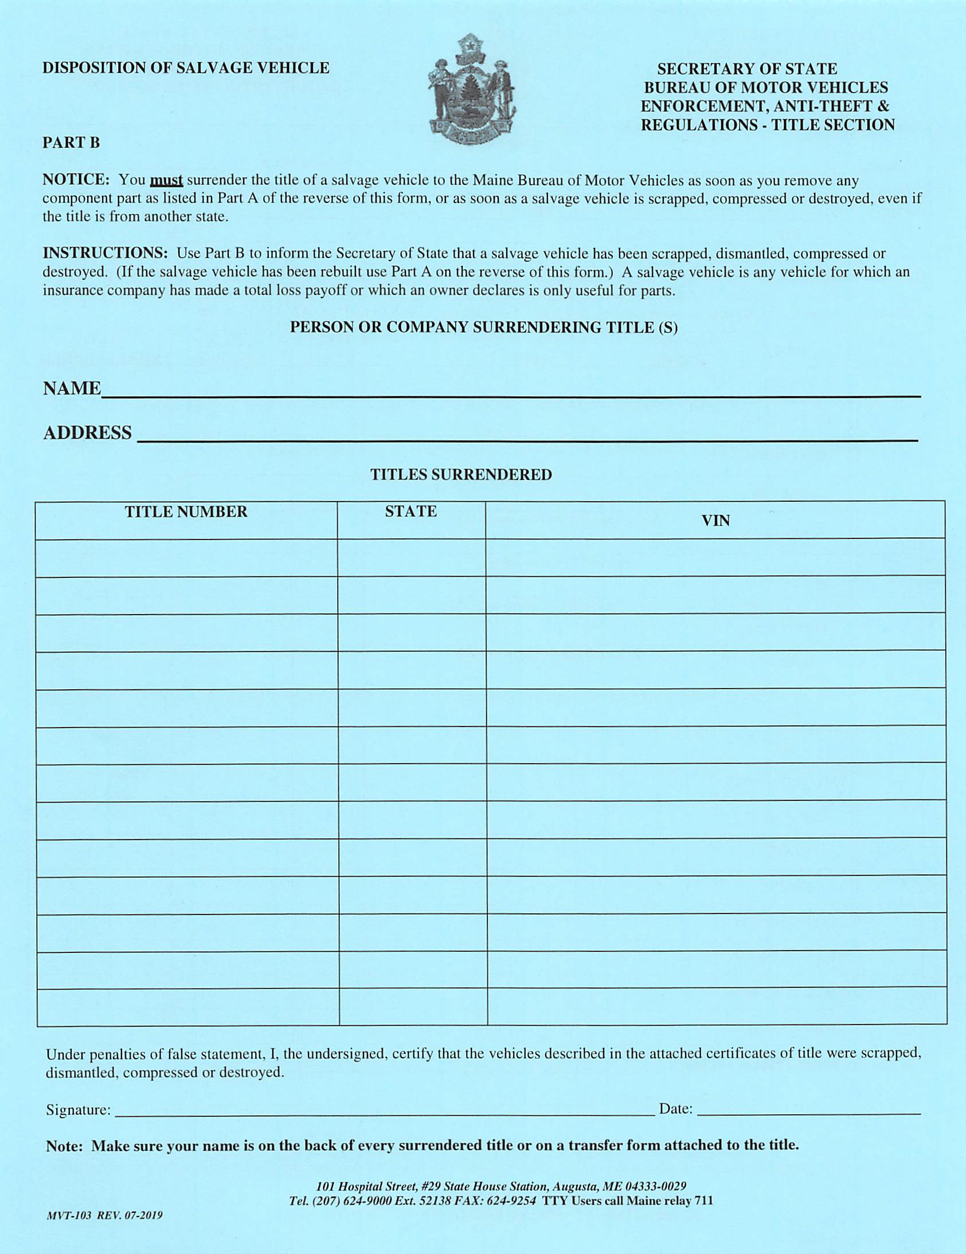
Reverse Side of
Disposition of Salvage Vehicle
MVT-103
Always Repair It
156 Repair Road Augusta Me 04330
10549521
ME
123ABC456EFG78A9
10949521
ME
456ABC123EFG89A9
Kenneth Arrows 09/07/17

Slide 55
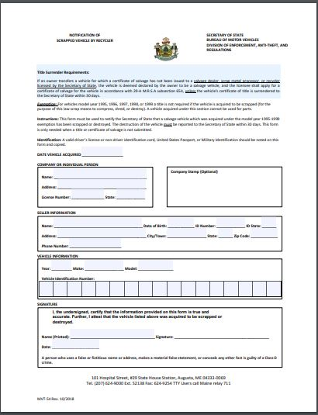
Notification of scrapped vehicle by recycler.
MVT-54

Slide 56
Certificate of Destruction
The Maine Bureau of Motor Vehicles will not title a vehicle that has been previously titled in another state as a Certificate of Destruction, Non-Repairable, Parts-Only, Junk, Scrap or equivalent brand.
The vehicle may be used as a “Parts” vehicle to repair other vehicles but may not be titled in Maine.

Slide 57
Special Circumstances
Minors (under the age of 18) applying for a Maine title, are required to have a parent or legal guardian sign the bottom of the title application (MVT-2).
A copy of the court order is required for emancipated minors.
Divorce Action: The recipient of the vehicle must show the divorce decree with the signature of the Judge.
Name Change: Changes due to marriage, divorce or personal preference are required to show a copy of the legal document stating such change.
Repossession: Between Jan. 1, 1991 and Oct. 1, 1996 titles with liens were mailed to the lienholders. A lienholder may repossess (MVT-5) when named as lienholder on the certificate of title.

Slide 58
Special Circumstances
Bankruptcy: A Bankruptcy Court Trustee must complete the assignment to whom a titled vehicle is sold and include a copy of the court order bankruptcy indicating who has authorization to transfer the vehicle with the submitted title application.
Incapacitated Owner: Two (2) witnessed signatures are required when the owner signs an X transferring title ownership of a vehicle, along with the title document, and copies of court appointed guardianship papers.
DSER ~ Department of Support Enforcement Regulations: Delinquent child support. Once a Notice of Lien is sent to the delinquent party, DSER can start lien proceeding after 20 days of the notice. It may be necessary to call the Title section to verify this information.

Slide 59
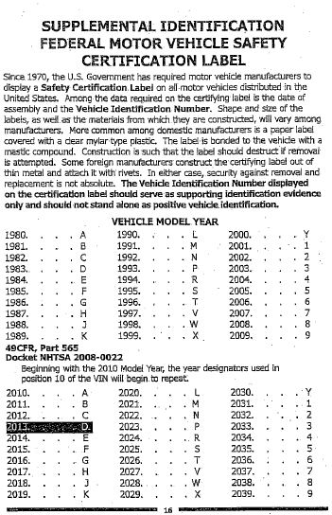
VIN Decoder
10th digit determines the model year of the vehicle

Slide 60
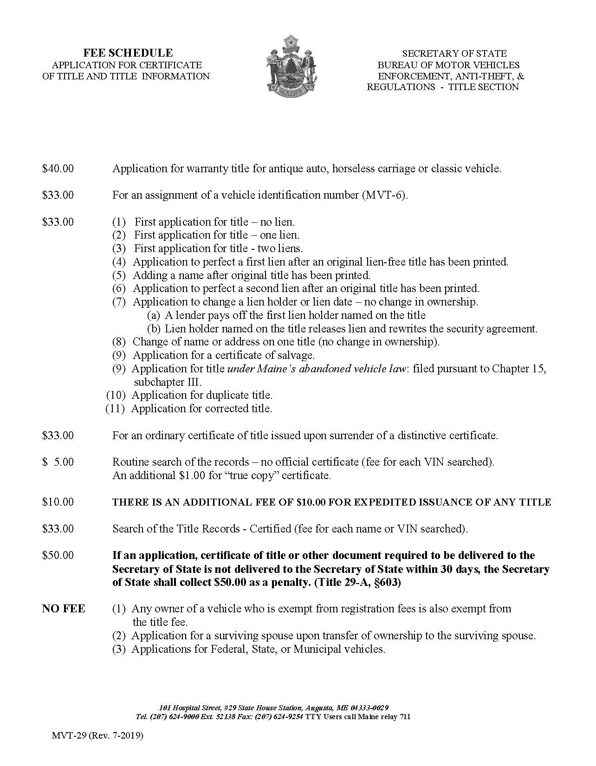
FEE SCHEDULE
MVT-29
Auctions may sell vehicles to a licensed Dealer without the title in hand; but the Dealer cannot sell the vehicle until the title has been received.
A Dealership must possess a properly assigned Title before selling or displaying a vehicle for sale.
Refer to MVT-29 for accurate Fee rates.

Slide 61
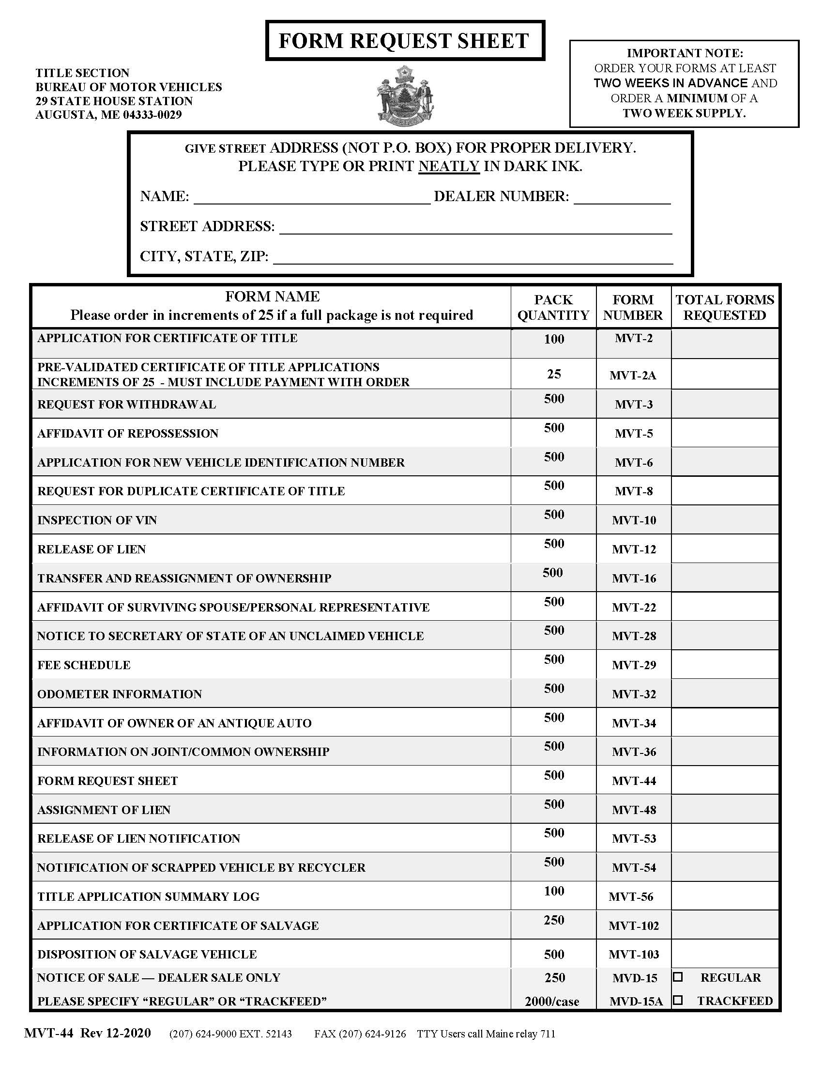

FORM REQUEST SHEET
MVT-44
STOCKROOM
(207) 624-9030

Slide 62
Contacting
Bureau of Motor Vehicles
~ Dealer Section ~
QUESTIONS?
CALL US AT:
(207) 624-9000 EXT. 52143
FAX
(207) 624-9126
EMAIL:
dealerlicensing.bmv@maine.gov

Slide 63
Contacting
Bureau of Motor Vehicles
~ Enforcement Unit~
QUESTIONS?
CALL US AT:
(207) 624-9000 EXT. 52144
FAX
(207) 624-9258
EMAIL:
investigation.bmv@maine.gov

Slide 64
Contacting
Bureau of Motor Vehicles
~ Title Section ~
QUESTIONS?
CALL US AT:
(207) 624-9000 EXT. 52138
FAX
(207) 624-9254
EMAIL:
titles.bmv@maine.gov

Slide 65


The End!
Please Remember to Call with Your Questions

